Slide 1

Ruxsatnoma Tizimi Windows
Doston Abdullayev

Slide 2

Windows
Ruxst turlari:
Full Control: Read+Write+Change+Delete
Modify: Read+Write+Delete
Read+Execute: Exe va boshqa fayllarni o’qish(read) hamda amalga oshiradi (execute)
Write: Jild(folder) yaratish, fayl yaratish hamda fayl contenti o’zgartirish imkonini breadi
Read: Jild (folder) ichidagi barcha malumotlarni o’qish ruxsatini beradi
F: Full access
D: Delete access
N: Modify access
R: Read-only access
W: Write-only access
M: Modify access
RX: Read & Execute access

Slide 3

Inherit/Meros
Inheret - Access Control List (ACL) tomonidan jild (folder) va fayllarni ruxsatini ifoda etishni onsonlashtirish uchun foydalaniladi:
(CI): Container Inherit
Nima uchun: Jild (folder) uchun - Container=Folder
Bunda subfolder ham asosiy jild(folder) ruxsatini o’z ichiga oladi fayllarsiz
(OI): Object Inherit
Nima uchun: fayllar uchun - Object=Files
Bunda faqat fayllar asosiy jild(folder) ruxsatlarini meros qilib oladi
(IO): Inherit Only
Bu huquq faqat farzand(child) jild(folder)ga meros qilib olinadi.
(NP): No Propagate Inherit
Bu holatda ruxsat faqat birinchi farzand(child)ga meros qilinadi qolganida to’xtaydi
(I): Inherited
Bu belgi ruxsat ota-ona(parent) jild(folder)dan meros qilinganini ifodalaydi

Slide 4
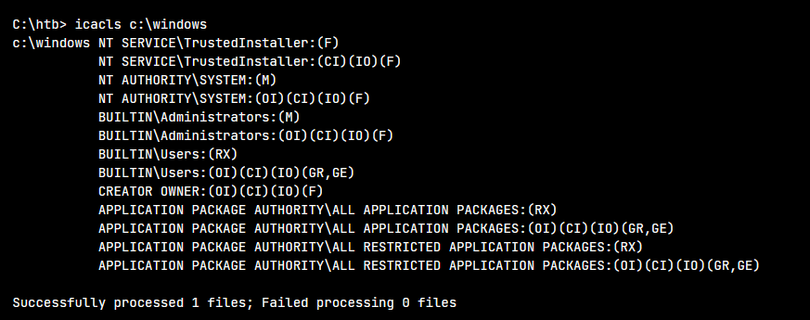
NAMUNA

Slide 5
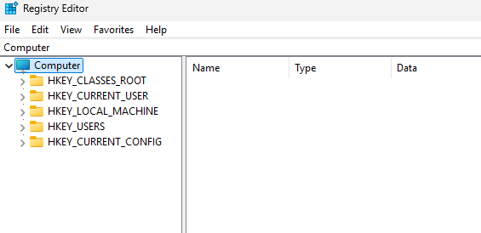
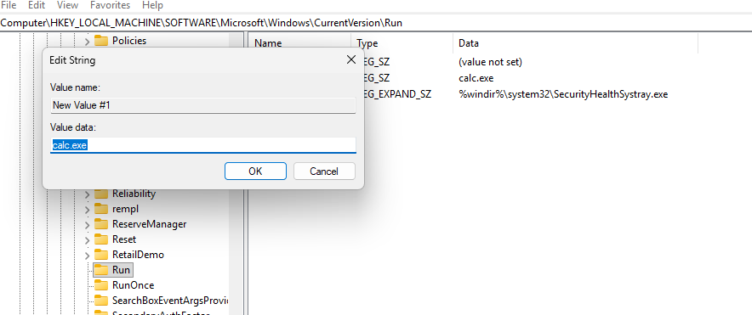
Amaliy
Win+R -> regedit
HKEY_LOCAL_MACHINE\SOFTWARE\Microsoft\Windows\CurrentVersion\Run
RUN ustiga sichqonchani o’ng tarafi bosib new->string
Value: calc.exe

Slide 6
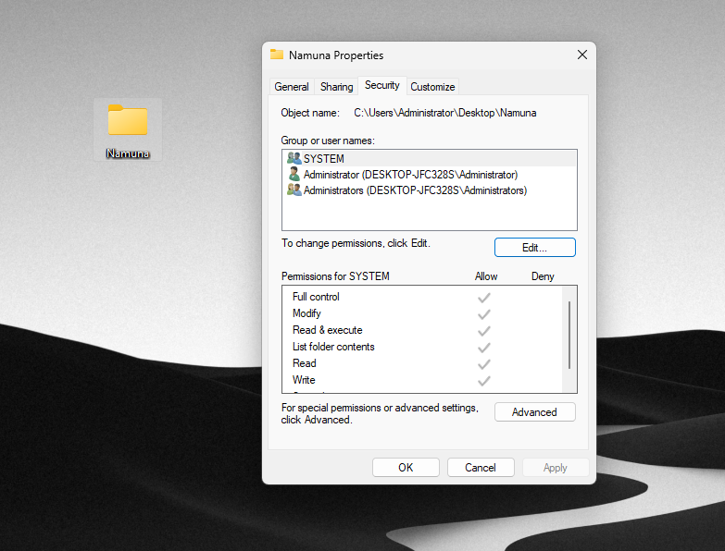
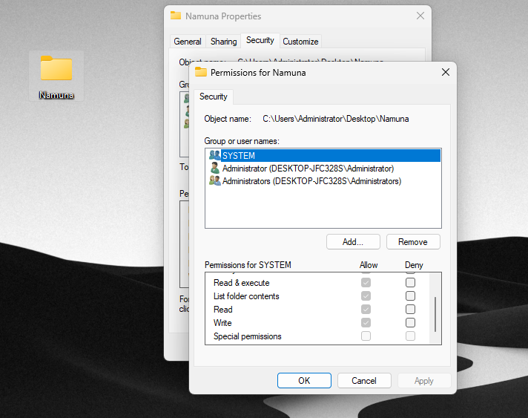
Ruxsat boshqarish amaliy
1. Desktopda sichqonchani o’ng tarafini bosing -> new-> folder
2. Jild (folder) ichiga xoxlagan .text file yaratib qo’ying
3. Jild(folder) ustiga sichqonchani o’ng tarafini bosib -> properties -> security

Slide 7
Ruxsat boshqarish amaliy
whoami
whoami /all
wmic useraccount list brief
net user student1 123abc /add - student1 bu login, 123abc bu parol
net user student2 123abc /add - Mashq uchun ikkinchi akkount kerak
mkdir C:\Test
icacls C:\Test /inheritance:r
icacls C:\Test /grant student1:F
icacls C:\Test /grant student2:R
icacls C:\Test
runas /user:student1 cmd
cd C:\Test
type nul > mashq.txt
dir
echo Ruxsat > mashq.txt
type mashq.txt
---
del mashq.txt

